Slide 1
Presentation Title Group Name and No
Contributions of different members
Member 1 (Name ID): Intro and Feasibility Analysis
Member 2 (Name ID): Use Case and Activity Diagram
Member 3 (Name ID): DFD and ER diagram
Member 4 (Name ID): Sequence and Class diagram
Notes:
‹#›

Slide 2
Explain About your Project
For Instance
What is the story to make this project
Planning
Why build the system?
Analysis
Who, what, when, where will the system be?
Design
How will the system work?
Analysis of current system: What are the current drawbacks, restrictions or limitations
Analysis of Proposed System: Competitive Advantages, unique features, nobility, diversity, new dimensions or creative approach etc
‹#›

Slide 3
Requirement analysis
‹#›

Slide 4
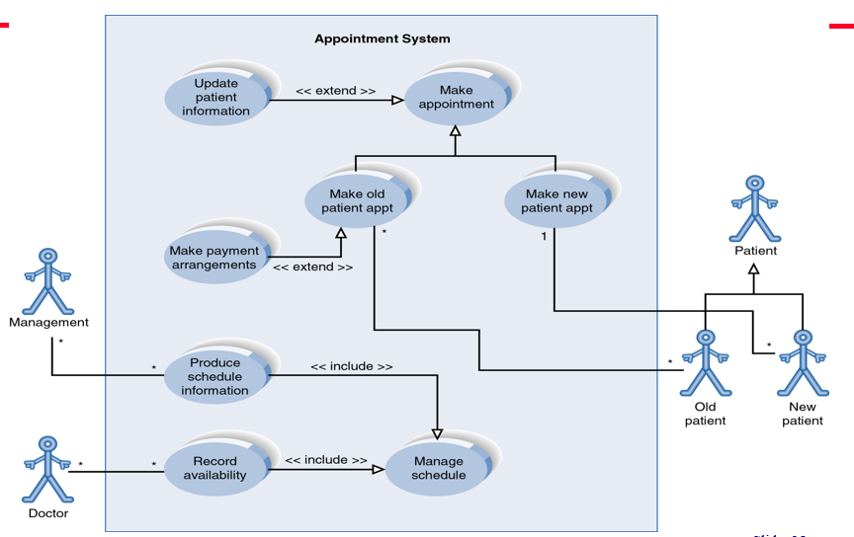
USE Case Diagram
‹#›

Slide 5
Class Diagram
‹#›

Slide 6
Activity Diagram
‹#›

Slide 7
Sequence Diagram
‹#›

Slide 8
DFD Diagram
‹#›

Slide 9
Summary and Conclusion
‹#›

